Slide 1
Face Recognition System: Application of Supervised Learning
Veeresha M Thotigar
Student ID : 1620975
Email ID : vmt9mm@mail.umkc.edu

Slide 2
Face Recognition
Face recognition systems generally divided into two categories:
Identification - set-up the similarity between a given face image and all the face images in a large database is computed, the top match is returned as the recognized identity of the subject.
Verification - set-up the match between a given face image and the face image is computed, the returned result as the authentication of the subject.

Slide 3
ATT - Dataset
The AT&T database is freely downloadable and contains a set of 400 face images (http://www.cl.cam.ac.uk/research/dtg/attarchive/facedatabase.html)
There are ten different images of each of 40 distinct subjects
For some subjects, the images were taken at different times, varying the lighting, facial expressions (open / closed eyes, smiling / not smiling) and facial details (glasses / no glasses)

Slide 4
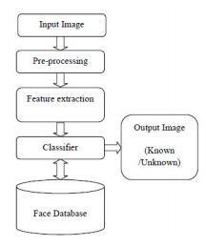
Architecture diagram

Slide 5
Algorithm - Principal Component Analysis
The PCA or Eigenfaces method is one of the most widely used linear statistical techniques reported
The classification step chooses to be the simplest Euclidean distance classifier.

Slide 6
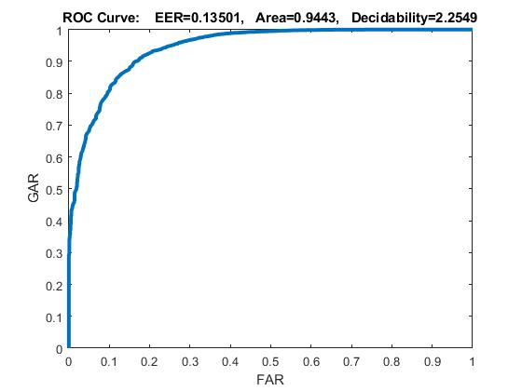
Mode 1
For each subject, use the first five images (1.pgm to 5.pgm) for training the subspace. Use the files 6.pgm to 10.pgm for the performance evaluation.

Slide 7
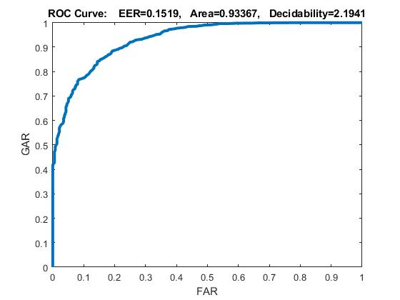
Mode 2
Use the first twenty five subjects (1.pgm to 10.pgm) for training the subspace. Use the rest 15 subjects for the performance evaluation.

Slide 8
Conclusion
Mode 1 has EER 0.135 when compared to Mode 2 has EER 0.151. It clearly shows that mode 2 has more EER than mode 1. For authentication face recognition system requires the genuine acceptance rate to be precise as per results the mode 1 is more suitable, for identification face recognition system requires FAR to be more precise and as per the results Mode 2 performs well and more suitable.

Slide 9
Thank you

